Slide 1
GNU Radio
Chen Zhifeng
Chen Ke-Yu
Electrical and Computer Engineering
University of Florida

Slide 2
Outline
Why GNU Radio?
Extensive knowledge involved
What is implemented currently?
Library
Architecture
Development environment
Development Boards
Current Issues
What is next?

Slide 3
Why GNU Radio?
Almost free!
  All the software are free (Python and C++ source code/linux environment)
  In most condition, no need expensive RF test machine!
  No need to purchase development and emulation tools
  Only a development board needed (Universal Software Radio Peripheral)
Flexible
  Software:
    reconfigurable for many other modulation methods for both standardize radio or self-defined radio
    it is possible to improve the quality of the received signal by utilizing, in software, certain mathematical algorithms
  Hardware:
    Rx and Tx are selectable
    Intermediate frequency is controllable
Best choice for research use and radio amateur

Slide 4
Extensive knowledge involved
Software and environment:
  Python/Numeric python library/wxPython
  C++/boost C++ libraties
  Linux environment and lots of support packages: FFTW/cppunit/SWIG/SDCC/
  GNU Radio architecture
Communications and RF:
  DSP
  Digital communications
  Wireless communications theory
  FPGA and Assemble language may be used

Slide 5
What is implemented currently
Base System
  Provides the runtime and various signal processing primitives
Hardware Support
  Universal Software Radio Peripheral (USRP)
Audio Device Support
  ALSA (Advanced Linux Sound Architecture)
  OSS (Open Sound System)
Graphics Support
  wxPython based GUI
  SDL video library
General Signal Processing
Specialty Application Areas

Slide 6
Library
Communication related implementation
  AM demodulation
  Differential BPSK / QPSK
  GMSK modulation / demodulation
  Narrow band FM transmitter / receiver
  Wide band FM transmitter & broadcast FM receiver

Slide 7
Library (cont.)
GNU radio utilities
  CRC generator
  Socket setup (TCP / UDP)
  Compute frequency response of a digital filter
  Control National IMX2306 & SDR-1000 frequency synthesizer
  Some utilities
    Convert unsigned mask into signed integer
    Gcd, Lcm, Log2
    Return input ‘x’ that is reverse order

Slide 8
Library (cont.)
GUI examples
  Provide window application for different usage
  FFT sink test
  wxPython EditBox, Slider
  Drawing
  Waterfall sink test
  Oscilloscope Test Application

Slide 9
Library (cont.)
pager
  Create USRP source object supplying complex floats
  Flex pager protocol demodulation block

Slide 10
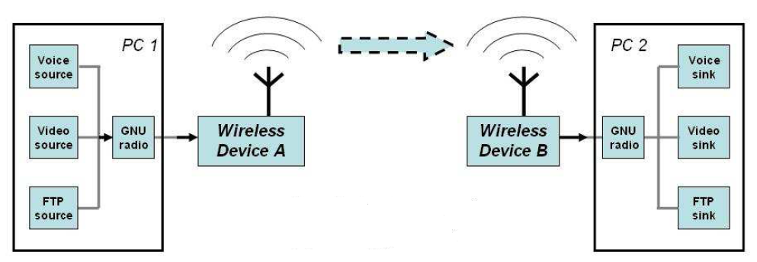
Architecture – overall
Hardware
Software

Slide 11
Architecture – Hardware
Sender
User-defined
Code
USB
FPGA
DAC
RF
Front end
PC
USRP (mother board)
Receiver
User-defined
Code
USB
FPGA
ADC
RF
Front end

Slide 12
Architecture – Hardware
User-defined
Code
USB
FPGA
DAC
RF
Front end
Support USB2.0/At this stage, USB 1.x is not supported at all
Support 32MB/sec across the USB.
All samples sent over the USB interface are in 16-bit signed integers in IQ format,
  16-bit I and 16-bit Q data (complex), resulting in 8M complex samples/sec
  across the USB.

Slide 13
Architecture – Hardware
User-defined
Code
USB
FPGA
DAC
RF
Front end
  Includes digital down converters (DDC) implemented with cascaded integrator-comb (CIC) filters.
  DDC
    Down converts the signal from the IF band to the base band.
    Decimates the signal so that the data rate can be adapted by the USB 2.0 and is reasonable for the computers' computing capability.
  Digital up converters (DUCs) on the transmit side are actually contained in the AD9862 CODEC chips, not in the FPGA.
  The only transmit signal processing blocks in the FPGA are the interpolators.

Slide 14
Architecture – Hardware
User-defined
Code
USB
FPGA
DAC
RF
Front end
  4 high-speed 14-bit DA converters, DAC clock frequency is 128 MS/s
  (stay below about 50MHz or so to make filtering easier.)
  4 high-speed 12-bit AD converters, sampling rate is 64M samples per second.

Slide 15
Architecture – Hardware
User-defined
Code
USB
FPGA
DAC
RF
Front end
  One mother board support up to four daughter boards.
  2. Several kinds of daughter boards available

Slide 16
Architecture – Software
Sender
User-defined
Code
USB
FPGA
DAC
RF
Front end
PC
GNU radio has provided some useful APIs
What we are interested in at this time is how to use the existing modules that has been provided in GNU radio project to communicate between two end systems

Slide 17
Architecture – Software
How these modules co-work?
  C++
    Performance-critical modules
  Python
    Glue to connect modules
    Non performance-critical modules

Slide 18
Architecture – Software
V1
V1
C++
C++
V3
V3
V2
C++
C++
V2
Sink
C++
C++
Source
At python level, what we need to do is always just to draw a diagram showing the signal flow from the source to the sink in our mind.

Slide 19
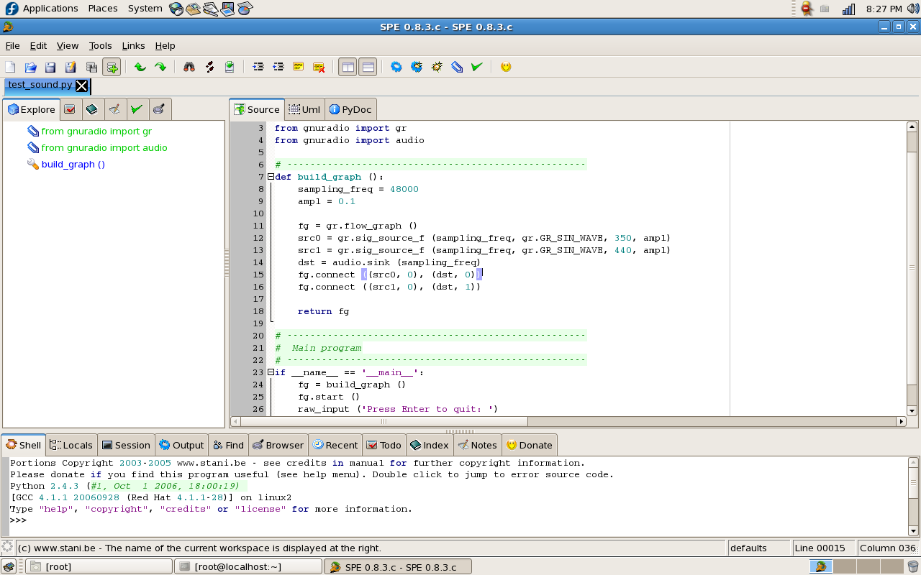
Development environment
SPE (Stani’s Python Editor)
  Free
  Lack of powerful debug tool (breakpoint)
Explorer of
Project and
Class members
Code editor
Interpreter & debug window

Slide 20
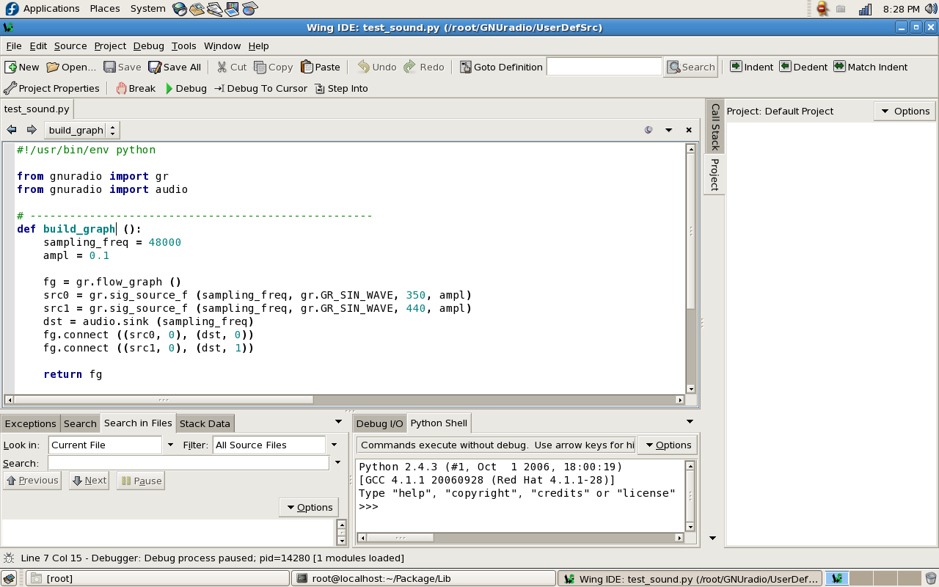
Development environment (cont.)
Wingware
  More powerful
  For personal version, the license fee to two stations are $60
Code editor
Explorer of
Project and
Class members
Debug
information
Interpreter

Slide 21
Development Boards
Description | Price
USRP Motherboard | $700.00
BasicTX -- 2 MHz to 200 MHz Transmitter | $75.00
BasicRX -- 2 MHz to 300+ MHz Receiver | $75.00
LFTX -- DC-30 MHz Transmitter | $75.00
LFRX -- DC-30 MHz Receiver | $75.00
TVRX -- 50 MHz to 870 MHz Receiver | $100.00
DBSRX -- 800 MHz to 2.4 GHz Receiver | $150.00
RFX400 -- 400-500 MHz Transceiver | $275.00
RFX900 -- 800-1000MHz Transceiver | $275.00
RFX1200 -- 1150 MHz - 1450 MHz Transceiver | $275.00
RFX1800 -- 1.5-2.1 GHz Transceiver | $275.00
RFX2400 -- 2.3-2.9 GHz Transceiver, 20+mW output | $275.00

Slide 22
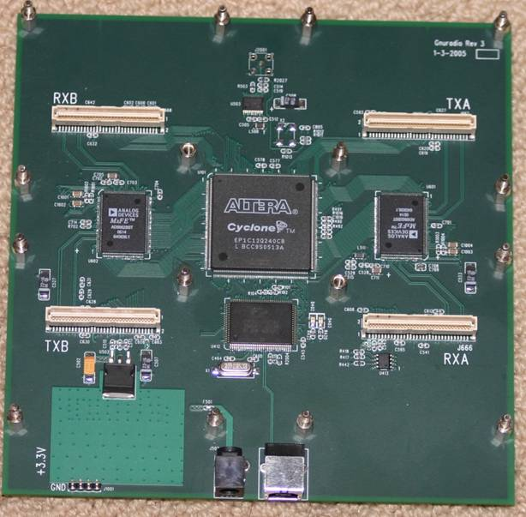
USRP Motherboard
Four 64 MS/s 12-bit analog to digital Converters
Four 128 MS/s 14-bit digital to analog Converters
Four digital downconverters with programmable decimation rates
Two digital upconverters with programmable interpolation rates
High-speed USB 2.0 interface (480 Mb/s)
Capable of processing signals up to 16 MHz wide
Modular architecture supports wide variety of RF daughterboards
Auxiliary analog and digital I/O support complex radio controls such as RSSI and AGC
Fully coherent multi-channel systems (MIMO capable)

Slide 23
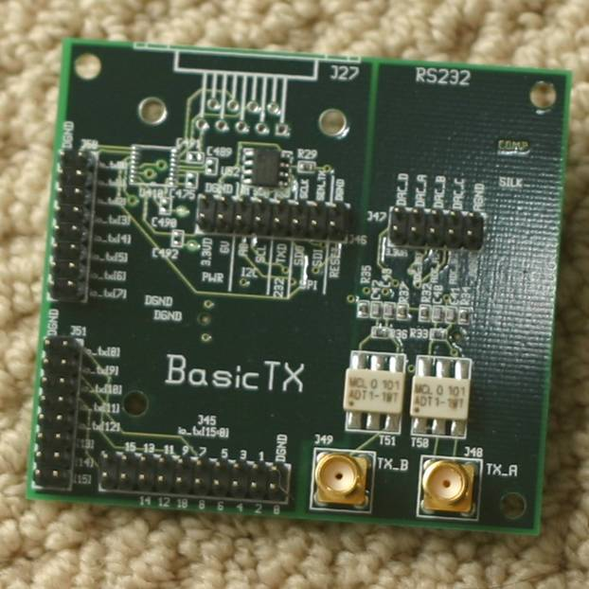
BasicTX
2 MHz to 200 MHz Transmitter
designed for use with external RF frontends as an intermediate frequency (IF) interface.
DAC outputs are directly transformer-coupled to SMA connectors (50Ω impedance)
direct access to all of the signals on the daughterboard interface

Slide 24
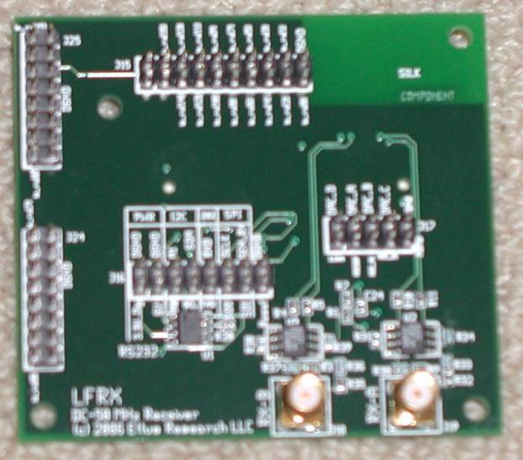
BasicRX
2 MHz to 300+ MHz Receiver
designed for use with external RF frontends as an intermediate frequency (IF) interface.
ADC inputs are directly transformer-coupled to SMA connectors (50Ω impedance)
direct access to all of the signals on the daughterboard interface

Slide 25
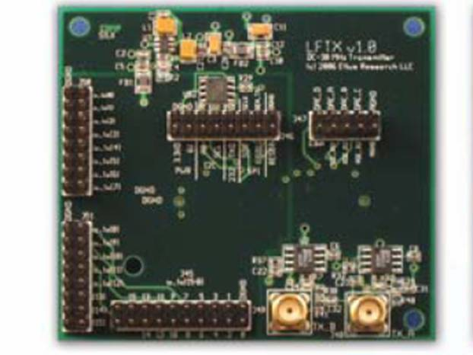
LFTX
DC-30 MHz Transmitter
very similar to the BasicTX and BasicRX, respectively, with 2 main differences
Use differential amplifiers instead of transformers, their frequency response extends down to DC.
have 30 MHz low pass filters for antialiasing.

Slide 26
LFRX
DC-30 MHz Receiver
very similar to the BasicTX and BasicRX, respectively, with 2 main differences
Use differential amplifiers instead of transformers, their frequency response extends down to DC.
have 30 MHz low pass filters for antialiasing.

Slide 27
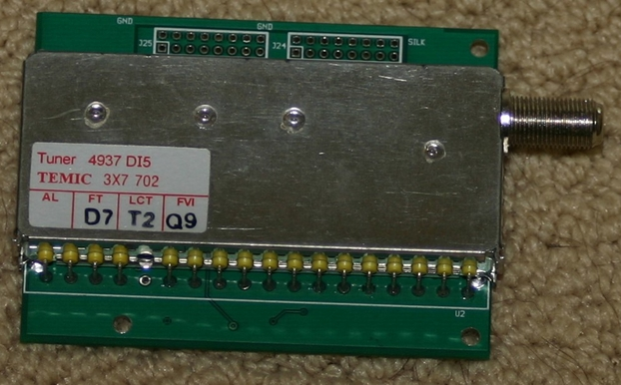
TVRX
50 MHz to 870 MHz Receiver
a complete VHF and UHF receiver system based on a TV tuner module
can receive a 6 MHz wide block of spectrum from anywhere in the 50-860 MHz range.
All tuning and AGC functions can be controlled from software.
  Note: The TVRX is the only daughterboard which is NOT MIMO capable. A MIMO capable version is expected in Q1 2007.

Slide 28
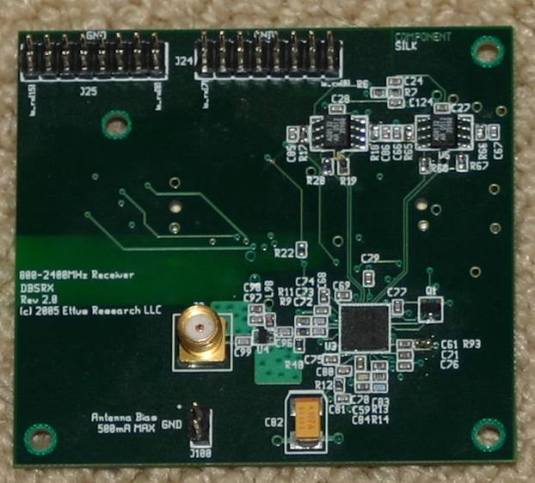
DBSRX
800 MHz to 2.4 GHz Receiver
a complete receiver system for 800 MHz to 2.4 GHz with a 3-5 dB noise figure.
features a software controllable channel filter as narrow as 1 MHz, or as wide as 60 MHz.
MIMO capable, and can power an active antenna via the coax.
Note: The DBSRX is NOT guaranteed to cover the 2.4-2.48 GHz ISM band.

Slide 29
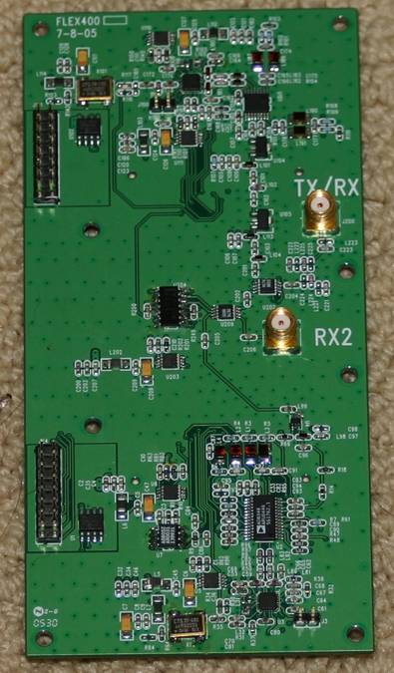
RFX400
400-500 MHz Transceiver
100+mW output (20dBm)
ideal for UHF TV, public safety and land-mobile communications, low-power unlicensed devices (like key-fobs), wireless sensor networks (motes), and amateur radio.
minor modifications to the board can move the frequency range to anywhere from 200 MHz to 800 MHz

Slide 30
RFX900
800-1000MHz Transceiver
200+mW output (23dBm)
with a 902-928 MHz ISM-band filter installed for filtering strong out-of-band signals (like pagers).
The filter can easily be bypassed to allow usage over the full frequency range, enabling use with cellular, paging, motes, and two-way radio, in addition to the ISM band.

Slide 31
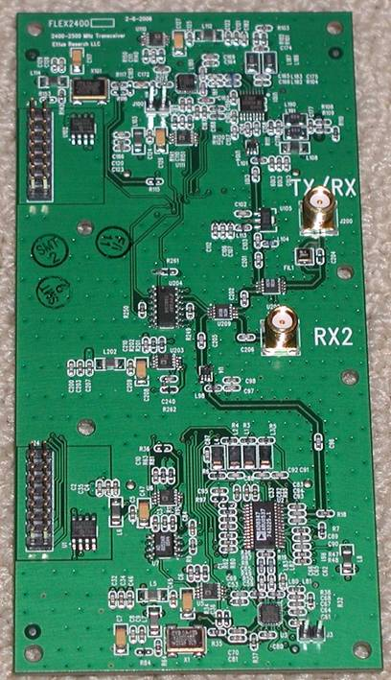
RFX1200
1150 MHz - 1450 MHz Transceiver
200+mW output (23dBm)
Coverage of navigation, satellite, and amateur bands.

Slide 32
RFX1800
1.5-2.1 GHz Transceiver
100+mW output (20dBm)
Coverage of DECT, US-DECT, and PCS (including unlicensed) frequencies.

Slide 33
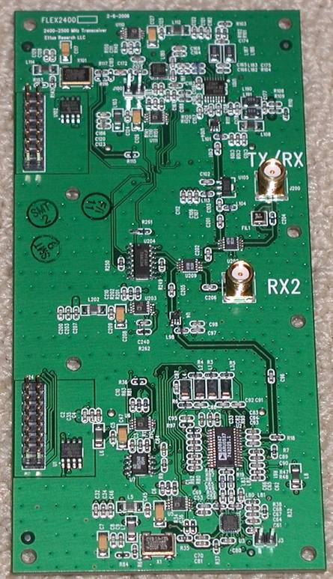
RFX2400
2.3-2.9 GHz Transceiver
50mW output (17dBm)
with a bandpass filter around the ISM band (2400-2483 MHz).
The filter can be easily bypassed, allowing for coverage of the full frequency range.

Slide 34
Demo
Hard Disk
Modulation
JPEG
Encoder
Socket
Hard Disk
Demodulation
Socket

Slide 35
Demo (cont.)
Modulation
Bit to Byte
Gray code
Encoder
Differential
Encoder
Real to
Complex
Demodulation
Byte to Bit
Gray code
Decoder
Differential
Decoder
Real to
Complex

Slide 36
Current issues
Need a USRP + Microtune 4937
Need a python IDE
A long way to be commercialized
  High performance CPU requirement
  The software is still under development

Slide 37
What is next?
--possible applications and issues
The clock recovery block doesn’t work in the DBPSK modulation
Add more functions, such as DQPSK, FSK… into our demo
We may test the transmission by actual wireless connection, since receiver doesn’t ensure correct demodulation, for example, carrier tracking, clock recovery, we may need to add:
  cyclic redundancy check (CRC)
  Retransmission control (ARQ)
Based on what we have done, we may deploy a research-oriented project next

